Slide 1
Aadhaar Data Valut
Submitted in the partial fulfillment for the award of the degree of
BACHELOR OF ENGINEERING
IN
CSE - INFORMATION SECURITY
Submitted by:
21BCS4222 - Shaik Adam Durwaish
21BCS3558 - Salibindla Bala Addarsh
21BCS3692 - Chinnari Abhishek
Under the Supervision of:
Prof.Raveet Kaur
Department of AIT-CSE
DISCOVER . LEARN . EMPOWER

Slide 2
Outline
Introduction to Project
Problem Formulation
Objectives of the work
Methodology used
Proposed System
Result & Output
Conclusion
Future Scope
References

Slide 3
Introduction to Project
Aadhaar is a 12-digit unique identification number issued by the Unique Identification Authority of India (UIDAI) to Indian residents
It is based on biometric and demographic data, providing a universal identity to residents.
A data vault could enhance security by implementing encryption algorithms and strict access controls..
A data vault typically involves structured storage and management of data, ensuring efficient retrieval and processing.
It often employs advanced encryption and access control mechanisms to protect data integrity and confidentiality..

Slide 4
Problem Formulation
Protecting the privacy of individuals is paramount, especially considering the sensitive nature of Aadhaar data..
Ensuring the integrity and confidentiality of the data within the proposed data vault is a critical concern..
Balancing the need for data access with the right to privacy is a key challenge..
Designing a system that allows users control over their data within the data vault while still enabling necessary access for authorized entities.
Handling the vast amount of data associated with Aadhaar in an efficient and organized manner.

Slide 5
Objectives
Certainly, outlining objectives for an Aadhaar data vault would help clarify the purpose and goals of such a system. Here are potential objectives presented in bullet points.
The system should aim to achieve the following goals:
Strengthen Data Security.
Ensure Strict Data Privacy.
Efficient and Responsive Data Management.
Ensure Strict Data Privacy.
Invest in Research and Development.

Slide 6
Methodology Used
The methodology for Aadhaar Data Vault involves the following steps:
Data Collection
Security and Privacy Framework Design
Model Selection and Training
Regulatory Compliance Assessment
Model Development
Authorized Access Controls
Testing and Quality Assurance
User Education and Awareness

Slide 7
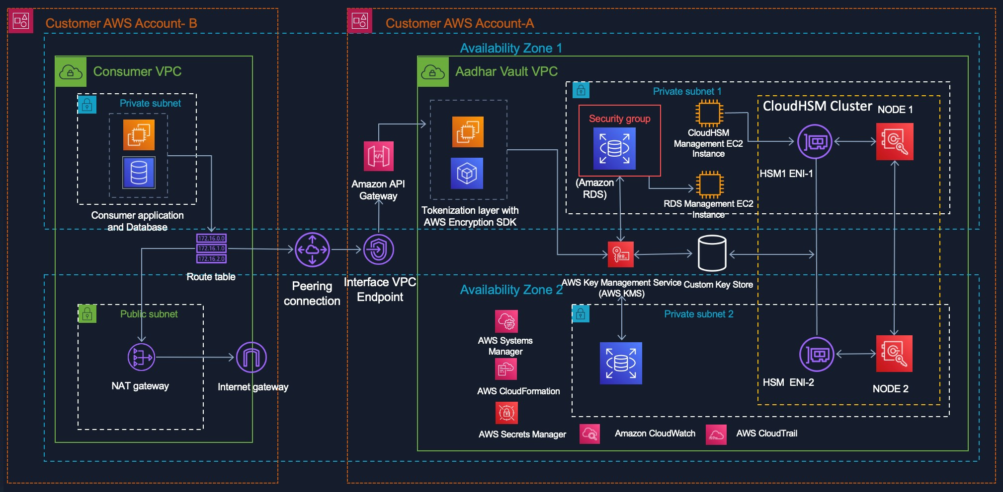
Methodology Used:

Slide 8
Proposed System
The proposed system for the Aadhaar Data Vault (ADV) is a secure and centralized repository for storing Aadhaar numbers and their corresponding demographic and biometric data. The ADV is designed to meet the stringent security requirements of the Aadhaar ecosystem and to ensure the protection of sensitive personal dataLogistic Regression:
Key Features of the Proposed System:
1) Centralized Storage: The ADV provides a centralized location for storing Aadhaar numbers and their associated data, ensuring consistency and accessibility of information.
2) Reference Key Mechanism: To reduce the footprint of Aadhaar numbers, the ADV employs a reference key mechanism. Reference keys are unique identifiers that are mapped to Aadhaar numbers within the ADV. Applications and entities authorized to access Aadhaar data utilize reference keys instead of directly handling Aadhaar numbers.
3) Robust Security: The ADV incorporates multiple layers of security measures, including encryption, access control mechanisms, and intrusion detection systems, to safeguard sensitive data.

Slide 9

Proposed System
4)Audit Trails and Monitoring: Comprehensive audit trails and monitoring capabilities are implemented to track access to Aadhaar data, ensuring accountability and enabling compliance with regulations.
Components of the Proposed System:
Data Storage
Encryption and Key Management
Access Control and Authentication
Audit Trails and Logging
Intrusion Detection and Security Monitoring
Disaster Recovery and Backups
Compliance and Regulatory Framework

Slide 10
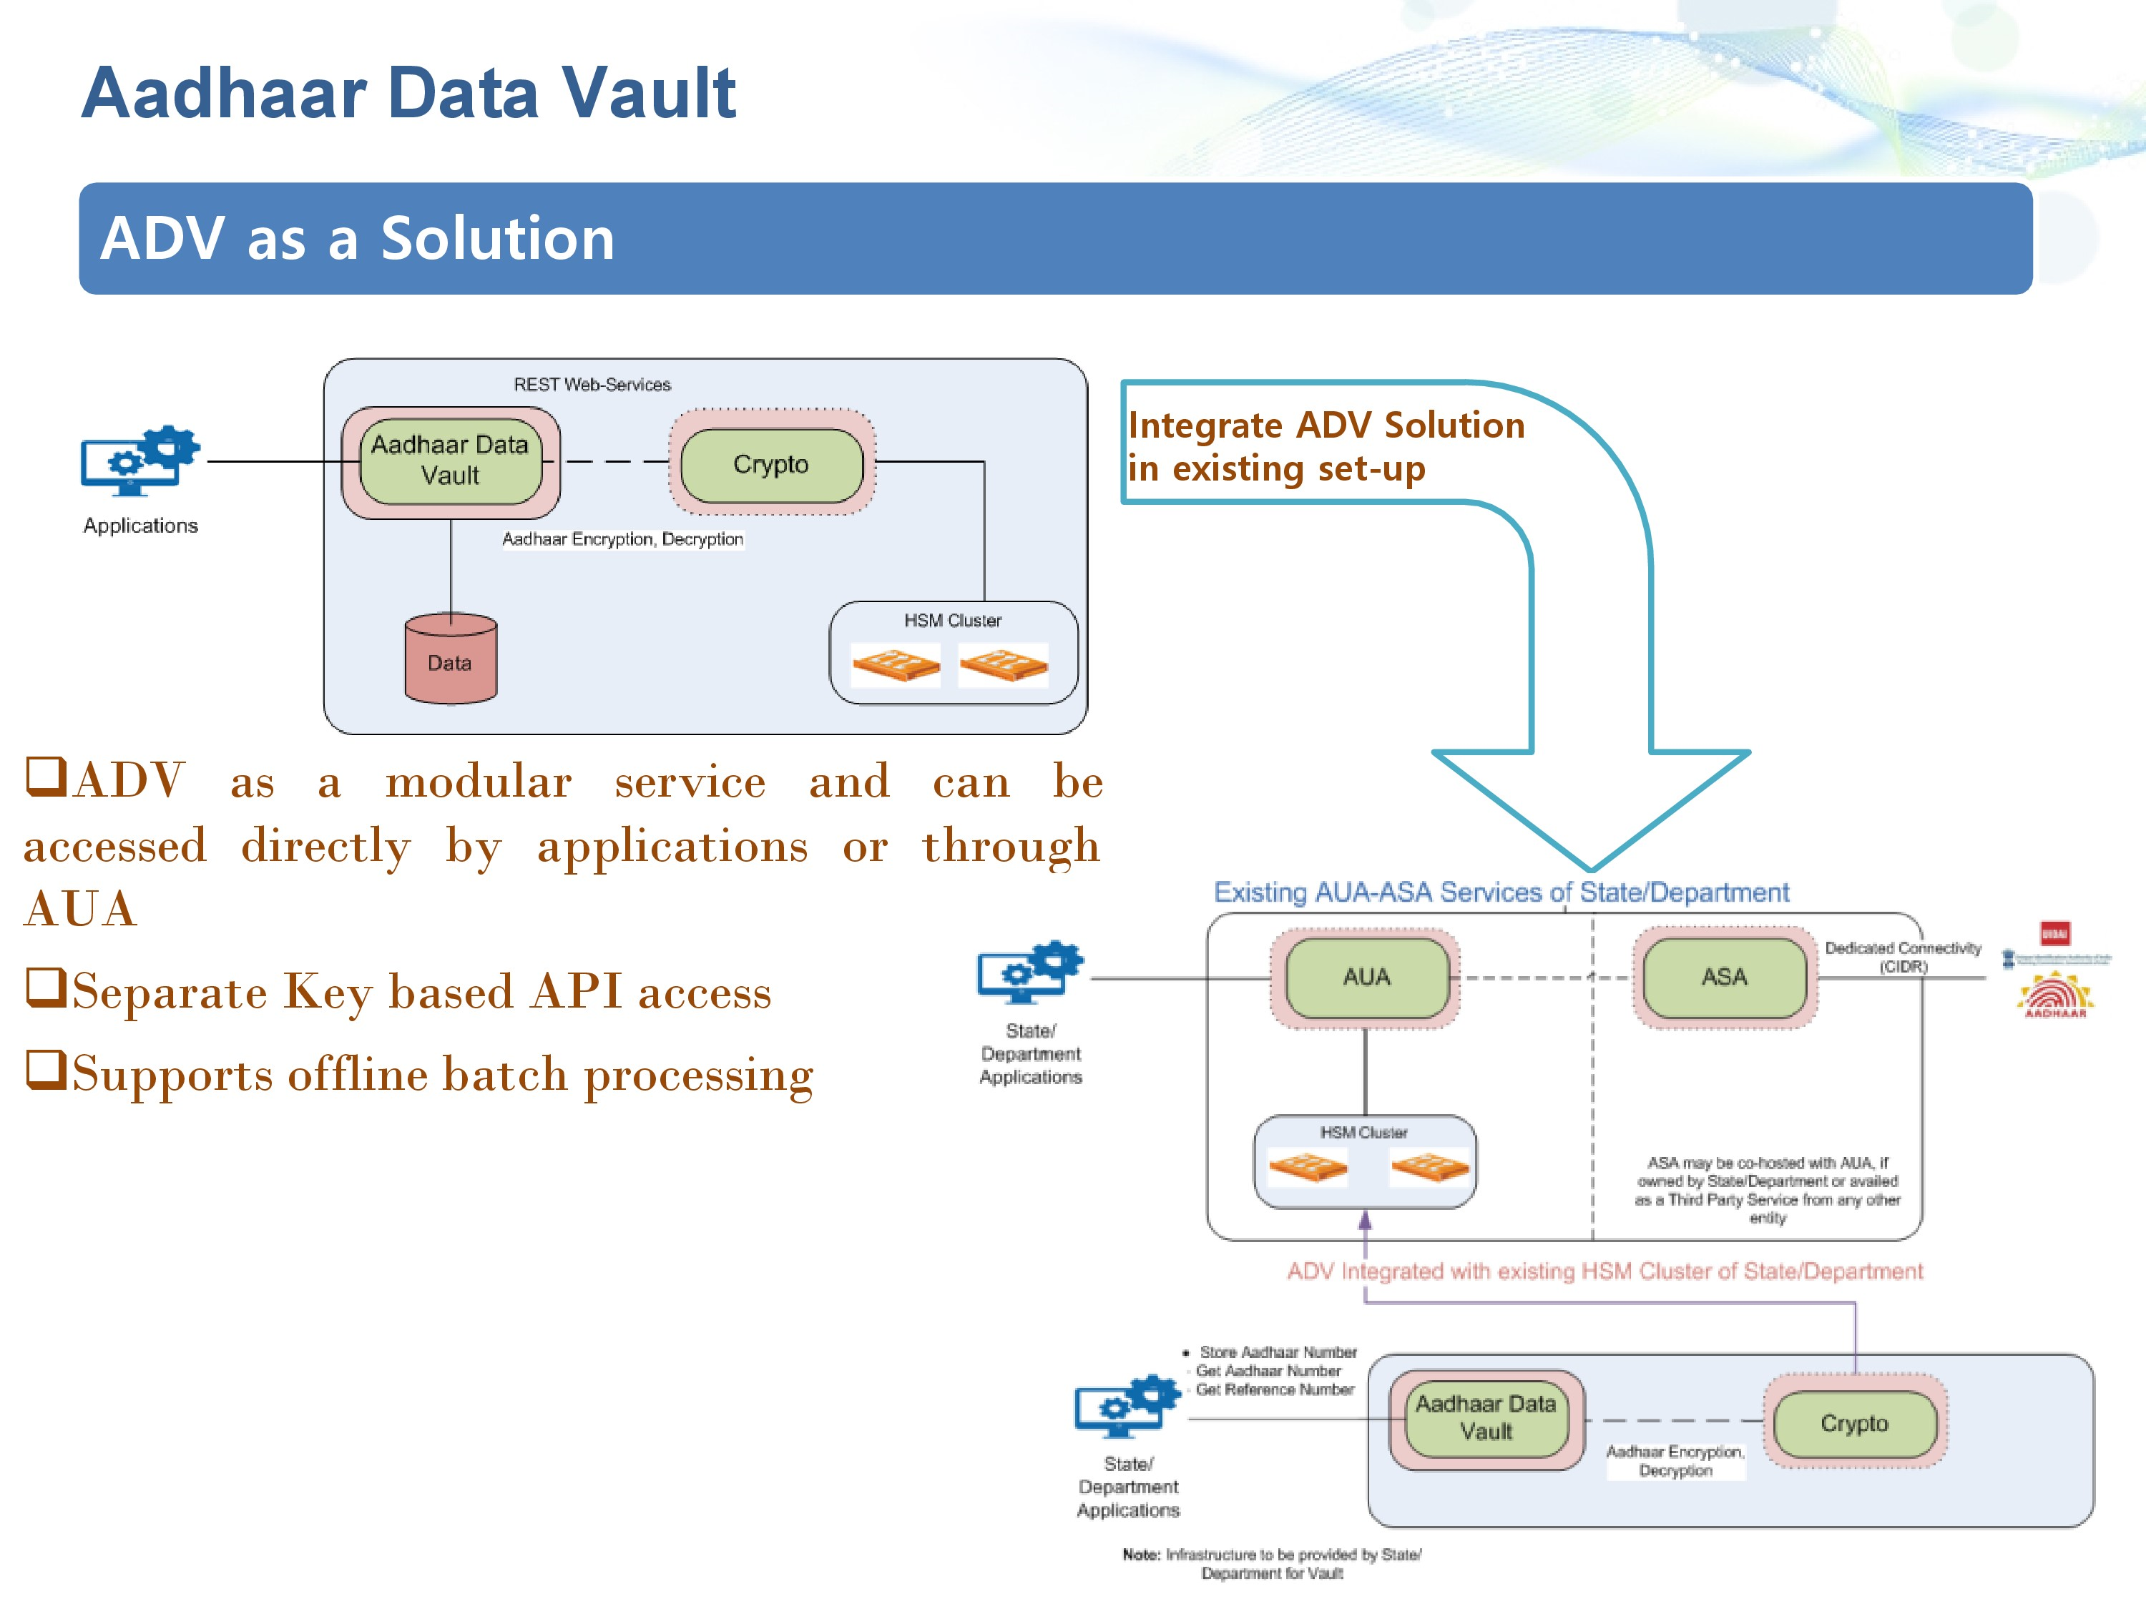
Result & Output
The ADV generates the following outputs:
Encrypted Aadhaar data: This is the core data stored in the ADV. It is encrypted using AES 256, a strong encryption algorithm.
Reference key database: This is a database that maps reference keys to Aadhaar numbers.
Audit log database: This is a database that stores all audit logs.
Security log database: This is a database that stores all security logs.

Slide 11
Conclusion
The ADV is a centralized and secure repository for storing Aadhaar numbers and their corresponding demographic and biometric data.
It is designed to meet the stringent security requirements of the Aadhaar ecosystem and to ensure the protection of sensitive personal data.
The ADV utilizes a reference key mechanism to reduce the footprint of Aadhaar numbers and enhance security.
It employs robust security measures, including encryption, access control mechanisms, and intrusion detection systems, to safeguard sensitive data.
The ADV provides comprehensive audit trails and monitoring capabilities to track access to Aadhaar data and ensure accountability.
The ADV adheres to all applicable data privacy regulations and compliance requirements to safeguard sensitive personal information.

Slide 12
Future Scope
Future developments may include more sophisticated biometric authentication methods to enhance the security of Aadhaar data vaults
The integration of blockchain technology could be explored to provide a decentralized and tamper-proof system for storing Aadhaar data. Blockchain can enhance transparency, security, and trust in the management of sensitive information.
The use of artificial intelligence (AI) and advanced analytics could enable better insights into Aadhaar data while maintaining privacy. This could involve the development of AI algorithms to detect patterns and anomalies in the data for security purposes.
The Aadhaar Data Vault helps to reduce the risk of data breaches by centralizing the storage of Aadhaar data and implementing strict access controls

Slide 13
References
[1] Unique Identification Authority of India (UIDAI). (2023). Aadhaar Data Vault(ADV). Retrieved from https://myaadhaar.uidai.gov.in/
[2] Ministry of Electronics and Information Technology (MeitY). (2023). Aadhaar Data Vault as a Service. Retrieved from https://epramaan.gov.in/
[3] Jain, A. K. (2018). Enhancing Aadhaar Data Security: The Importance of Aadhaar Data Vault. Journal of Information Security, 10(4), 285-298.
[4] Gupta, S., & Saxena, S. (2021). A Secure Aadhaar Data Vault for Data Protection and Privacy Enhancement. International Journal of Computer Applications, 194(12), 54-60.
[5] Kumar, A., & Patel, D. (2022). Performance Analysis of Aadhaar Data Vault for Secure Data Storage and Management. International Journal of Innovative Research in Science, Engineering and Technology, 11(12), 180-185
[6] Ahmad, M., & Gupta, S. (2023). Design and Implementation of a Secure Aadhaar Data Vault for Enhanced Data Protection. Journal of Network and Computer Applications, 164, 1-12.
[7] Kumar, R. (2023). A Practical Guide to Implementing and Managing Aadhaar Data Vault for Secure Data Storage. Apress

